Slide 1
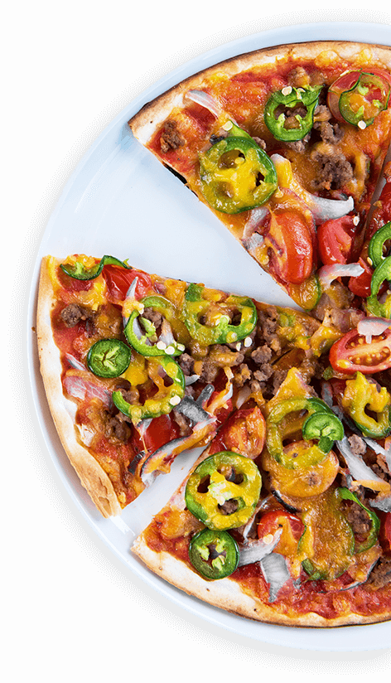
PIZZA
SALES ANALYSING
"Indulge in our mouthwatering pizzas - where every slice is a taste of perfection!"
PRESENTED BY GANESH KARWA

Slide 2
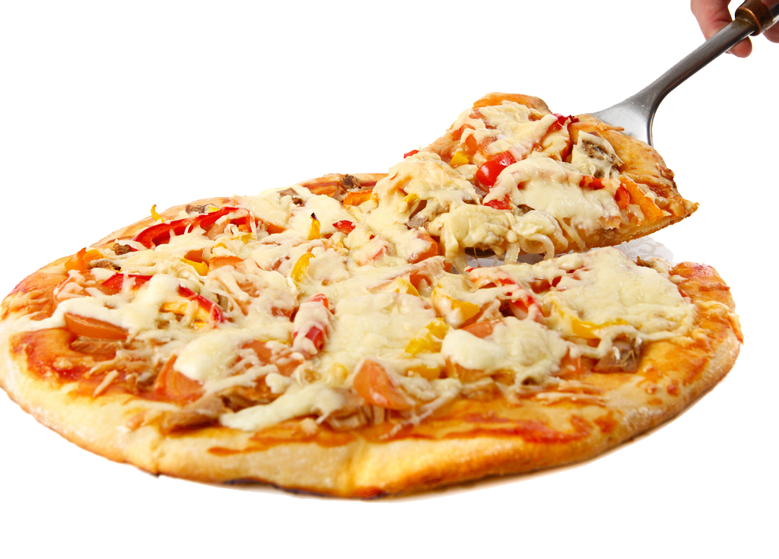
OBJECTIVE
The objective of this project is to analyze key indicators of pizza sales data to gain insights into business performance. By calculating metrics such as total revenue, average order value, total pizzas sold, total orders, and average pizzas per order, we aim to understand the dynamics of our pizza sales and identify areas for improvement.
Notes:
Image by kisspng.com

Slide 3
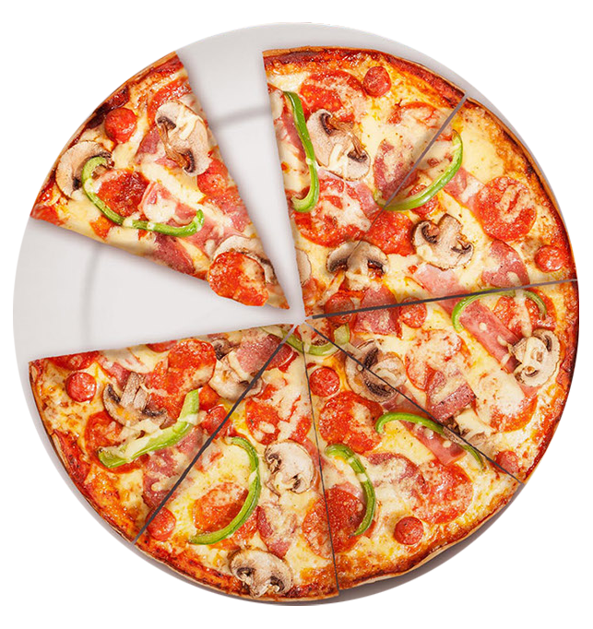
PIZZA
25%
"We aim to conduct an in-depth analysis of our pizza sales data to glean valuable insights into the performance of our business. Our primary objective is to identify key indicators that provide a comprehensive understanding of our sales dynamics and overall business health.
75%
Notes:
Image by pngfly.com

Slide 4
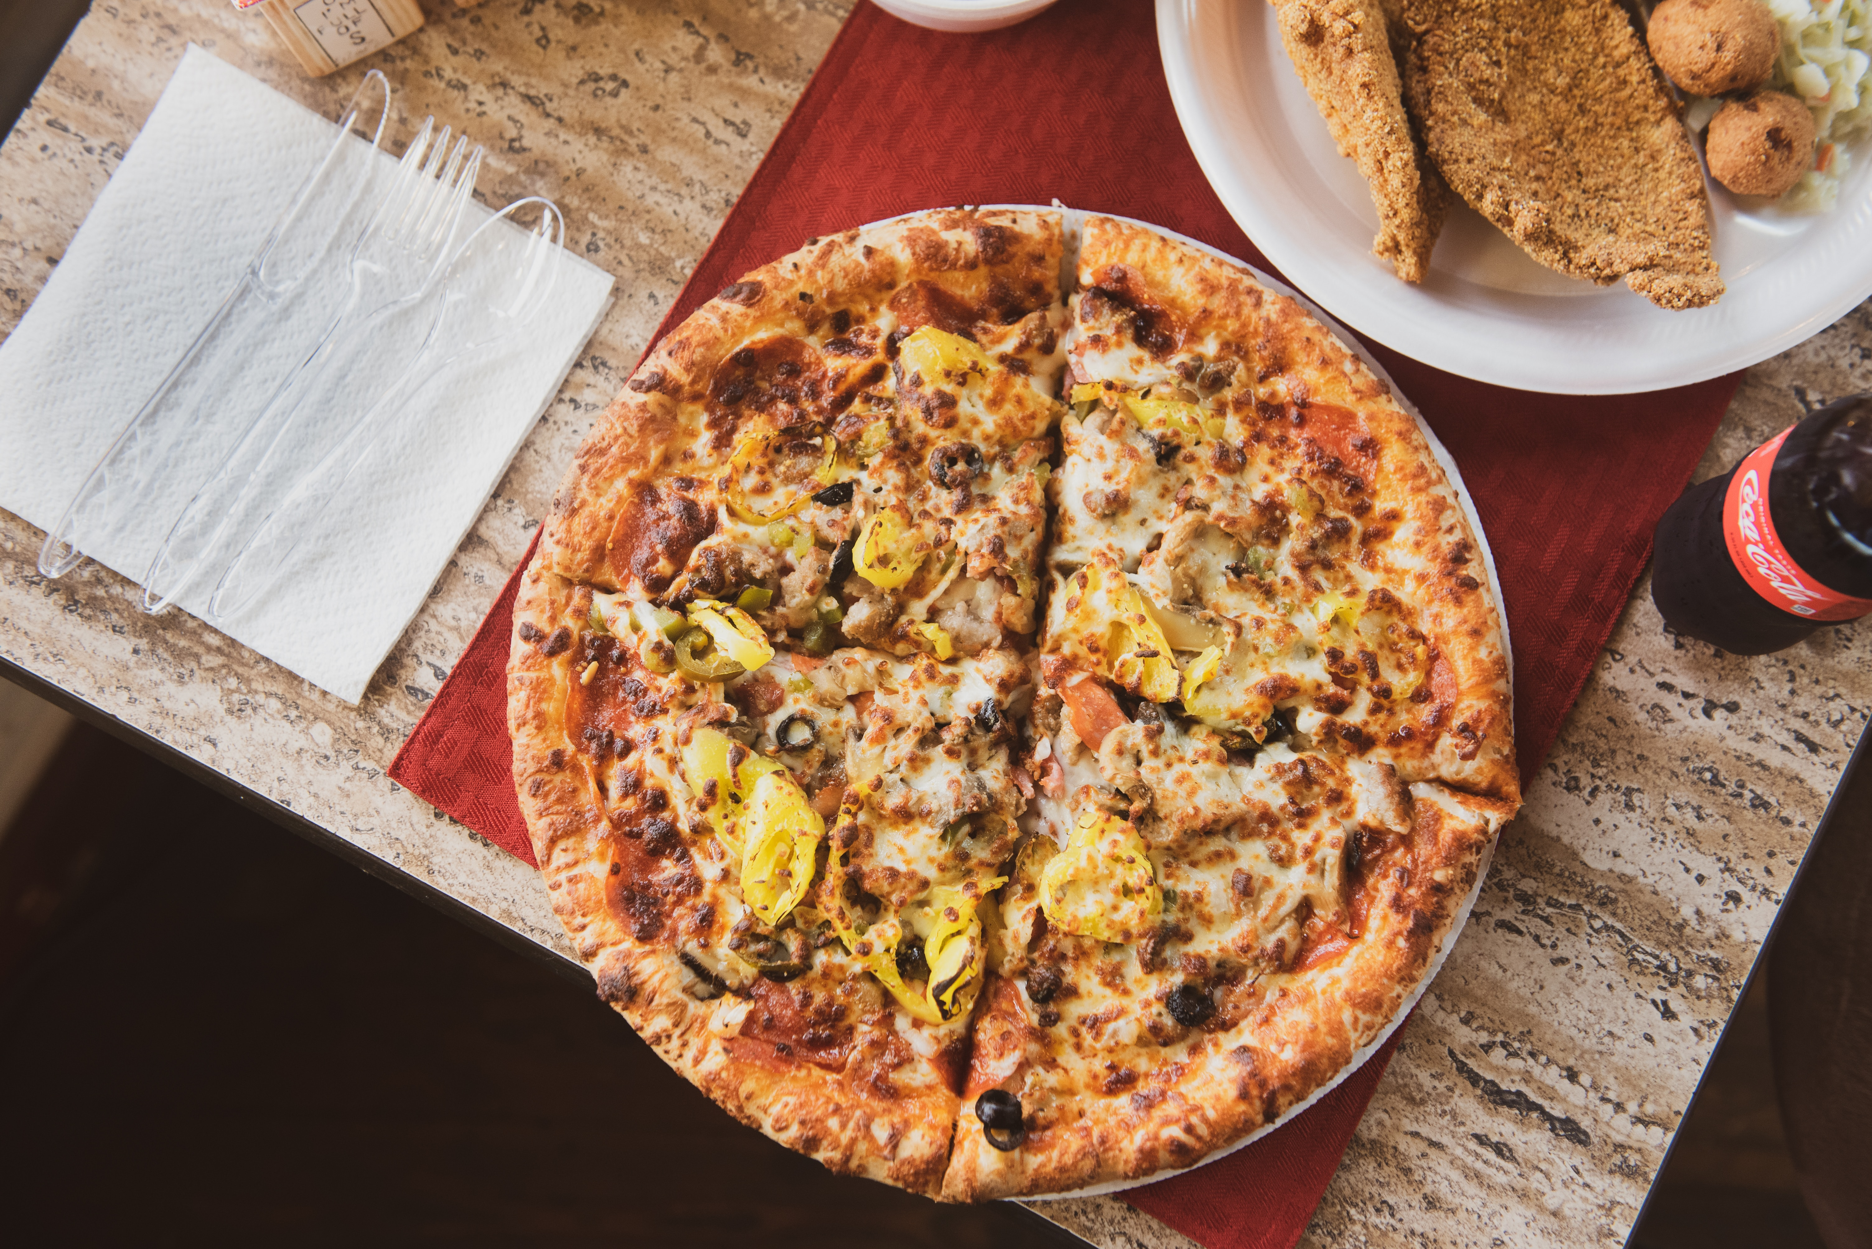
Data Analysis: The project involves analyzing sales data from a pizza business, focusing on key metrics such as total revenue, average order value, total pizzas sold, and total orders.
Visualization of Trends: Through charts and graphs, the project aims to visualize sales trends, including daily and hourly trends for total orders, percentage of sales by pizza category and size, and total pizzas sold by category.
DESCRIPTION
Identification of Top Sellers: The project identifies the top 5 best and worst-selling pizzas based on total pizzas sold, providing insights into customer preferences and popular menu items.
Actionable Recommendations: By analyzing metrics and insights, the project aims to provide actionable recommendations for optimizing business operations and enhancing customer satisfaction.
Notes:
Photo by Jodie Morgan on Unsplash

Slide 5
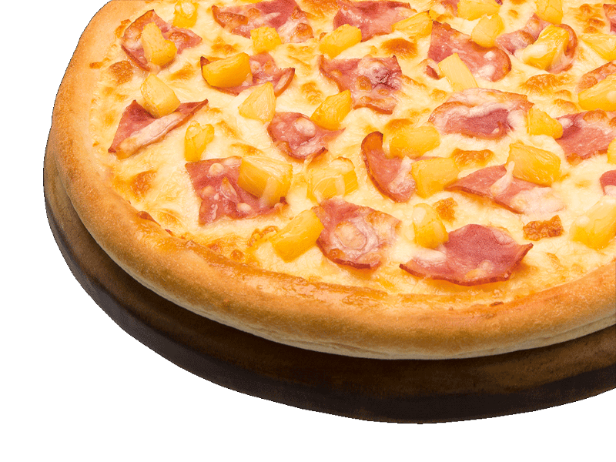
We aim to analyze key indicators for our pizza sales data to gain insights into our business performance. Specifically, we want to calculate the following metrics:
PROBLEM STATEMENT
Total Revenue: The sum of the total price of all pizza orders.
Average Order Value: The average amount spent per order, is calculated by dividing the total revenue by the total number of orders.
Total Pizzas Sold: The sum of the quantities of all pizzas sold.
Total Orders: The total number of orders placed..
Average Pizzas Per Order: The average number of pizzas sold per order, calculated by dividing the total number of pizzas sold by the total number of orders..
Notes:
Image by pngfly.com

Slide 6
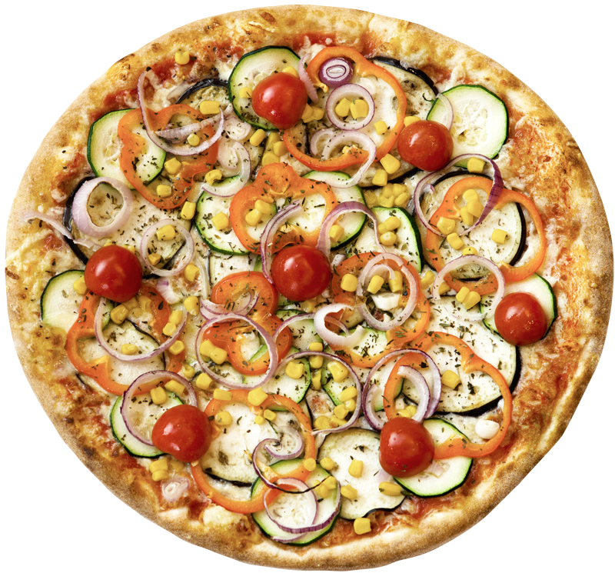
CHARTS REQUIREMENT
:
Percentage of Sales by Pizza Size a pie chart that represents the percentage of sales attributed to different pizza sizes. This chart will help us understand customer preferences for pizza sizes and their impact on sales.
Daily Trend for Total Orders:
Create a bar chart that displays the daily trend of total orders over a specific period. This chart will help us identify any patterns or fluctuations in order volumes daily..
Hourly Trend for Total Orders:
Create a line chart that illustrates the hourly trend of total orders throughout the day. This chart will allow us to identify peak hours or periods of high-order activity.
Total Pizzas Sold by Pizza Category:
Create a funnel chart that presents the total number of pizzas sold for each pizza category. This chart will allow us to compare the sales performance of different pizza categories.
Percentage of Sales by Pizza Category:
Create a pie chart that shows the distribution of sales across different pizza categories. This chart will provide insights into the popularity of various pizza categories and their contribution to overall sales.
Top 5 Best Sellers by Total Pizzas Sold:
Create a bar chart highlighting the top 5 best-selling pizzas based on the total number of pizzas sold. This chart will help us identify the most popular pizza options.
Notes:
Image by pngfly.com

Slide 7
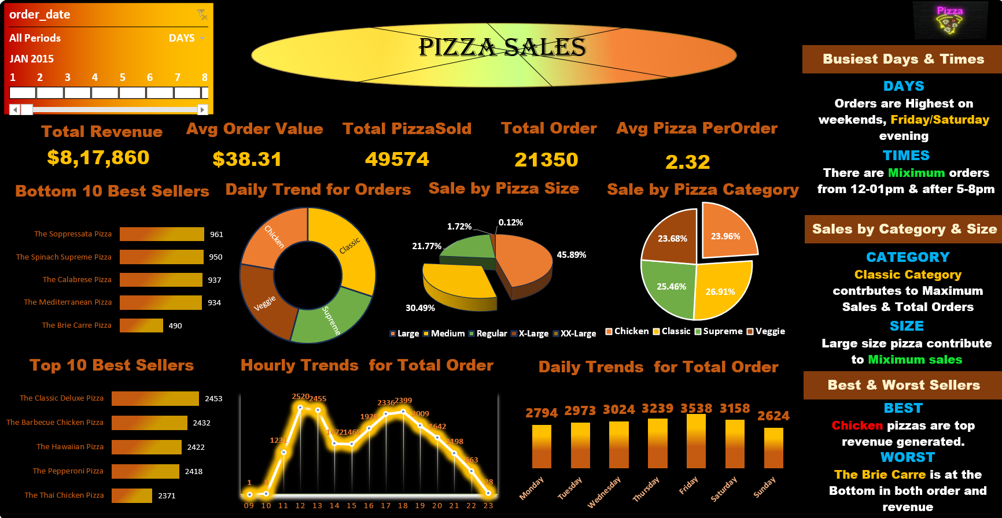

Slide 8
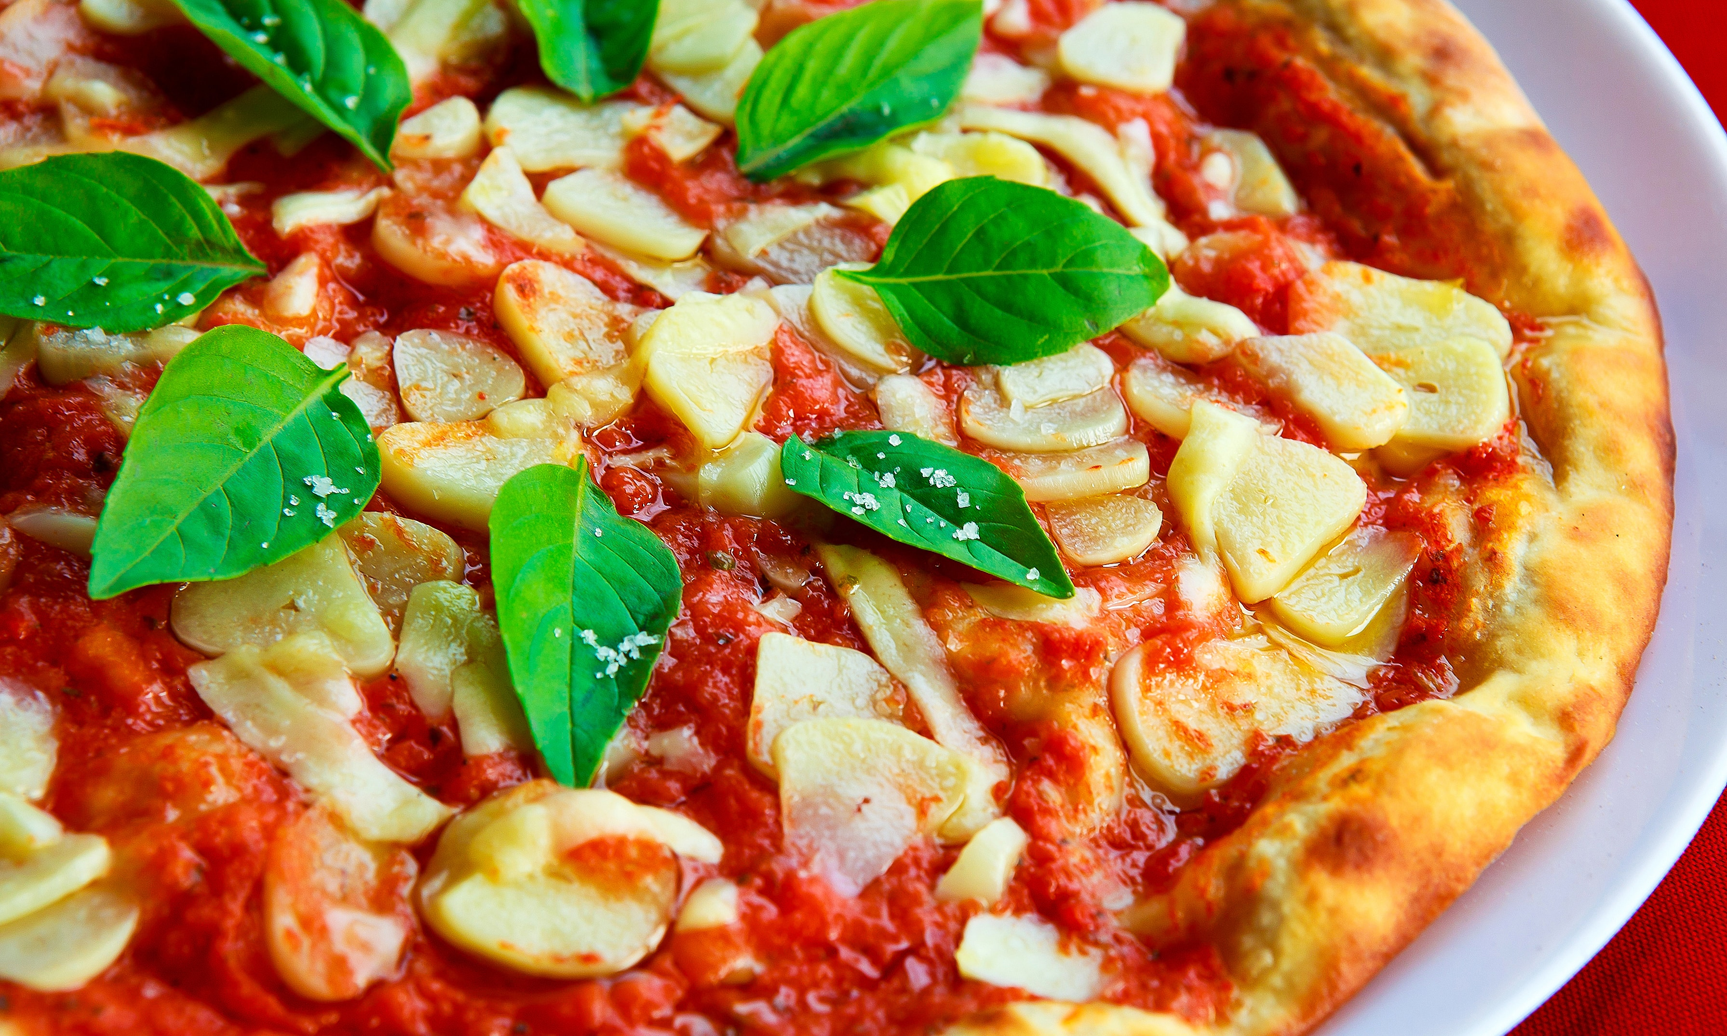
PIZZA
ANALYSIS
Busiest Days & Times:
Days: Orders are highest on weekends, particularly Friday and Saturday.
Times: Maximum orders occur from 12-1pm and after 5-8pm.
Sales by Category & Size:
Category: The Classic category contributes to maximum sales and total orders, followed by Prime Veggie.
Size: Large size pizzas contribute to the maximum sales.
Best & Worst Sellers:
Best Sellers: Chicken pizzas generate the highest revenue.
Worst Sellers: The Brie Carre pizza is at the bottom in both revenue and total orders.
Notes:
Photo by Cel Lisboa on Unsplash

Slide 9
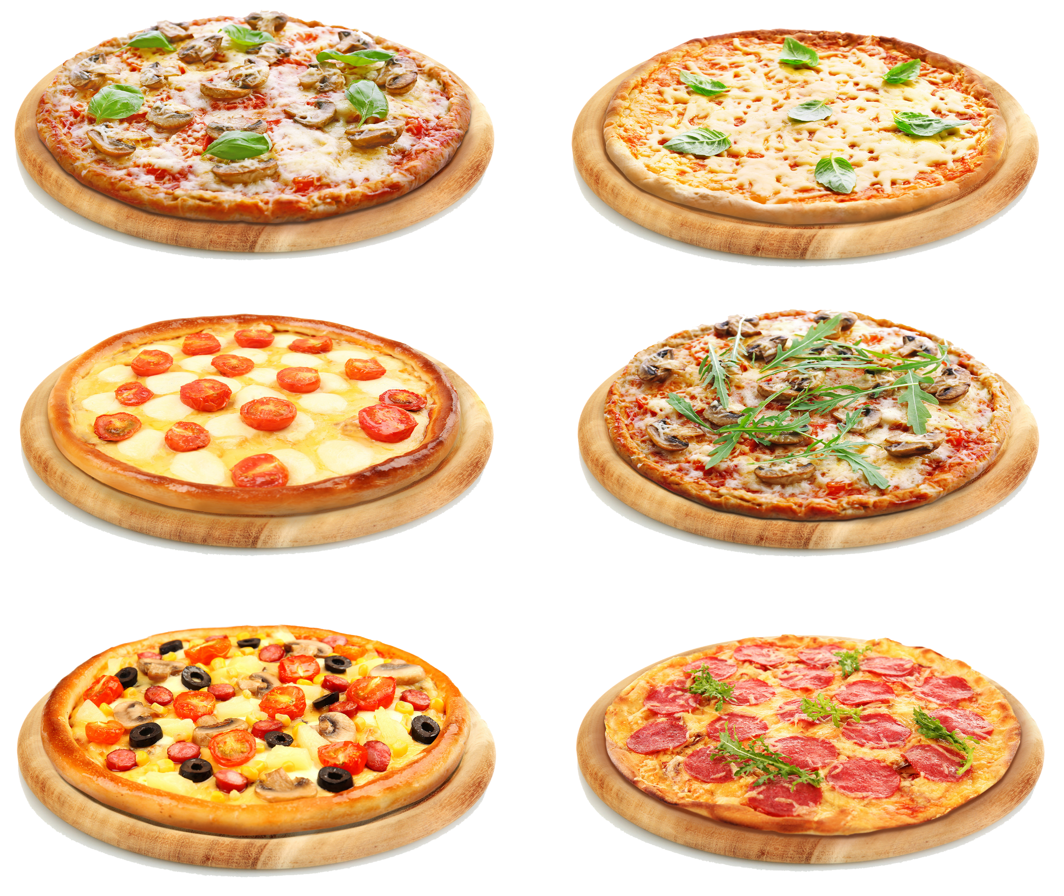
PIZZA INSIGHTS
Sales Trends: Weekends, particularly Fridays and Saturdays
Best & Worst Sellers: Chicken pizzas emerge as the top revenue generators, while the Brie Carre pizza ranks lowest
Peak Hours: Maximum orders occur during lunchtime (12-1pm) and in the evening (5-8pm),.
Customer Preferences: Understanding customer preferences for pizza categories and sizes can help tailor marketing strategies
Sales by Category & Size: Classic pizzas contribute significantly to total sales and orders, with large size pizzas
Best pizza customer demands
Notes:
Image by pngfly.com

Slide 10
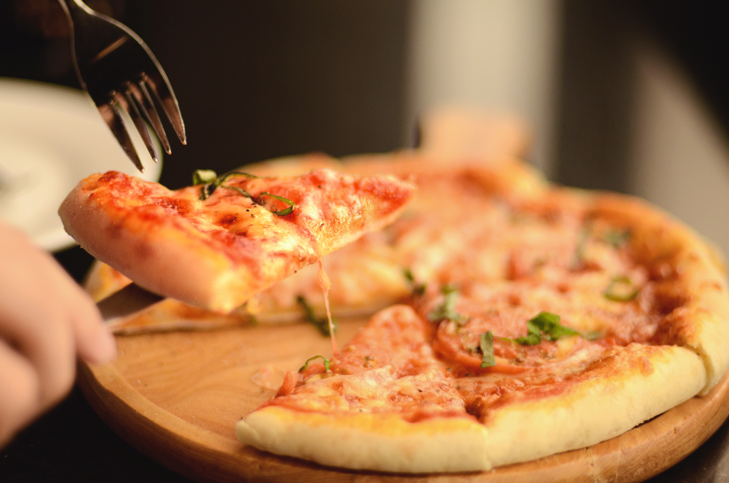
CONCLUSION
Through comprehensive analysis of pizza sales data, we've gained valuable insights into our business performance. We've identified peak order times, popular pizza categories and sizes, as well as best and worst-selling pizzas. These insights can guide strategic decision-making processes, such as menu optimization, pricing strategies, and marketing campaigns, to enhance overall business efficiency and customer satisfaction..
30.49%
22%
45.89%
Notes:
Photo by Lim Lin on Unsplash

Slide 11
THANK YOU

